Slide 1

CMR COLLEGE OF ENGINEERING & TECHNOLOGY
Kandlakoya, Medchal, Hyderabad - 501401
Department of Computer Science and Engineering
Title of the Project
Health Coverage Advisor
Batch No.:12
Name of the student:
21H51A0534-D.SAI SUJAN
21H51A0535-D.SAHITHI
21H51A0536-D.V.S.S. JAYA PRAKASH
Under esteemed guidance of
Guide Name
Mr. G. Saidulu
Assistant Professor, CSE
Batch: 2021-2025 Mini Project II

Slide 2
Outline
Abstract
Introduction
Research Objective
Problem Statement
Scope of the Project
Research work
- Existing System / Relevant Work
- Proposed Methodologies
- System Architecture
- Comparison of Proposed system with an existing system
Results
Conclusion
Future Work
References
Notes:
2

Slide 3
Abstract
Notes:
3

Slide 4
ABSTRACT
This project simplifies the process of selecting healthcare insurance by utilizing machine learning technologies.
It gathers up-to-date policy data from various insurance providers and analyzes it alongside user-specific health information, including medical history and BMI.
This approach enables personalized recommendations, helping users choose the most suitable insurance coverage based on their unique health needs and financial preferences.
The project ultimately enhances decision-making by offering tailored, real-time policy options, saving users time and effort.

Slide 5
INTRODUCTION
Notes:
5

Slide 6
Introduction
The Health Coverage Advisor project aims to simplify the process of selecting healthcare insurance by providing personalized coverage estimates based on individual health data.
It involves aggregating real-time insurance policy information and analyzing it with machine learning to generate tailored recommendations.
The system will be evaluated through a survey to measure its effectiveness in improving user satisfaction and decision-making.
Notes:
6

Slide 7
Research Objective
Notes:
7

Slide 8
Research objective
1. Develop Personalized Coverage Estimates: Create a system that uses individual health data and real-time insurance policy information to generate accurate and personalized insurance coverage estimates.
2. Integrate Machine Learning for Recommendation: Employ machine learning algorithms to analyze aggregated data and provide tailored insurance recommendations based on users' health needs and financial preferences.
3. Evaluate System Effectiveness: Assess the system's impact on user decision-making and satisfaction through feedback and performance metrics, ensuring the recommendations are both accurate and useful.

Slide 9
Problem Statement
Notes:
9

Slide 10
Problem Statement
The project addresses the challenge of determining the appropriate level of insurance coverage by providing personalized estimates based on individual health data, enabling users to focus on health benefits rather than just cost when selecting insurance plans.

Slide 11
Scope of the Project
Notes:
11

Slide 12
Scope of the Project
Personalized Coverage Estimates: Provide tailored insurance coverage estimates based on individual health data and current policy information.
Data Aggregation and Analysis: Collect and analyze real-time insurance policy details using machine learning to match users with suitable plans.
Recommendation and Feedback Loop: Offer personalized insurance recommendations and gather user feedback to continuously improve the system’s accuracy and effectiveness.

Slide 13
Research Work
Notes:
13

Slide 14
Existing System / Relevant Work
1. Basic Coverage Calculators: Online tools that offer rough estimates based on user inputs like age and health status, but often lack detailed personalization.
2. Financial Planning Services: Professional advisors who estimate coverage needs as part of a broader financial plan, though they may not provide real-time data or automated analysis.
3. Insurance Carrier Tools: Tools from insurance companies that estimate coverage needs but are limited to their own products and do not compare options from multiple providers.
4. Health Risk Assessments: Platforms that evaluate health risks and provide general coverage guidance but may not offer detailed cost projections or personalized recommendations.

Slide 15
Proposed Methodologies
Data Aggregation: Gather real-time insurance policy information from various providers, ensuring comprehensive and current data. The dataset includes attributes like Age, Smoking Habits, BMI, No. of Children & Premium Amount.
2. Personalized Analysis: Use machine learning algorithms specifically Linear Regression Algorithm to analyze user-specific health data, such as medical history and BMI, in conjunction with the aggregated policy information to provide customized coverage estimates.
3. Recommendation Engine: Develop a recommendation system that integrates the analysis to generate tailored insurance options based on individual health needs and financial constraints.
4. Feedback Loop: Implement a user feedback mechanism to continuously refine the system’s algorithms and improve the accuracy and relevance of the insurance recommendations.

Slide 16
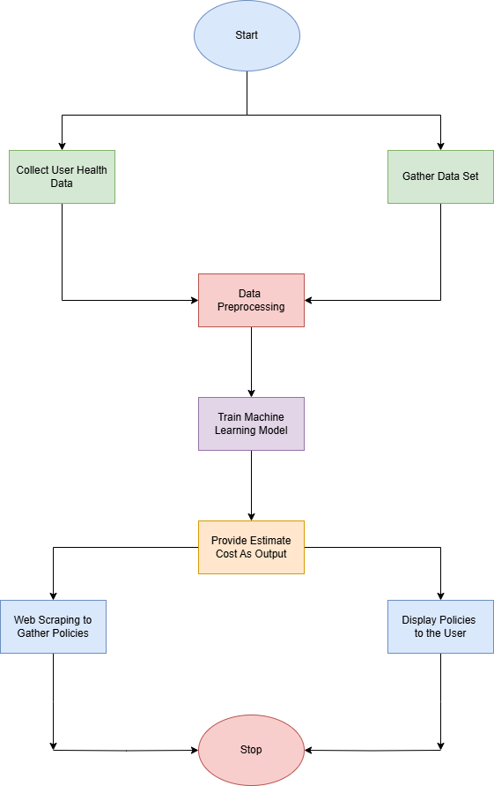
System Architecture

Slide 17
Comparison of Proposed system with an existing system
 | EXISTING SYSTEM | PROPOSED SYSTEM
DATA COLLECTION | Manual data entry or static policy information from a few providers. | Using machine learning to generate an accurate estimate.
RECOMMENDATION | Basic comparisons with limited insights into user health needs. | Tailored recommendations based on comprehensive analysis of health data and policy details.
ANALYSIS | Manual or simplistic tools with minimal data analysis. | Advanced machine learning models for deep analysis and pattern recognition.

Slide 18
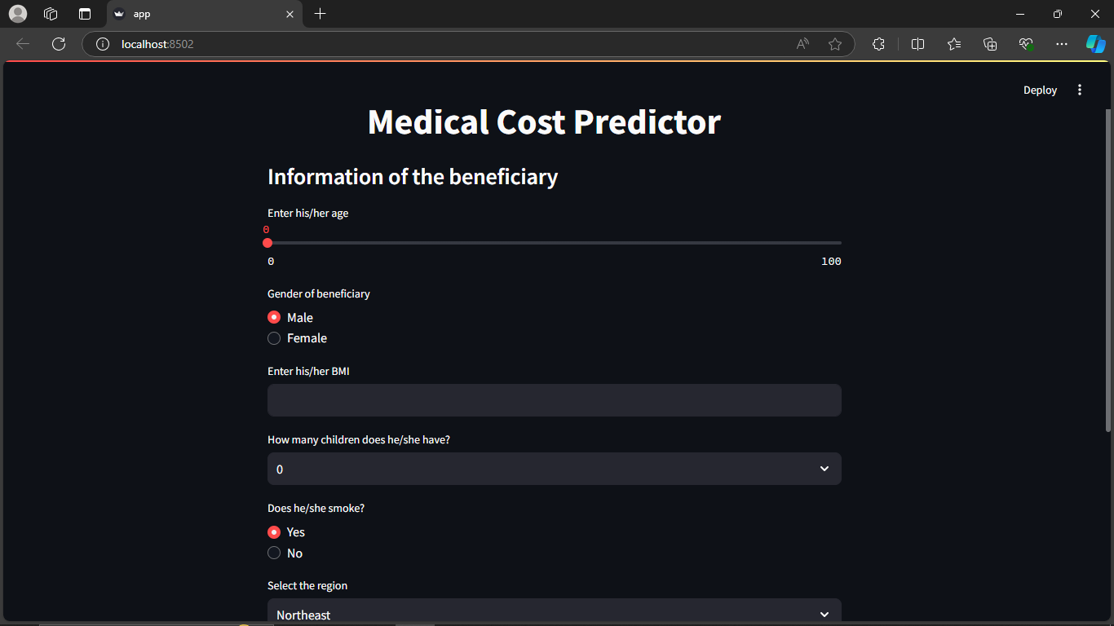
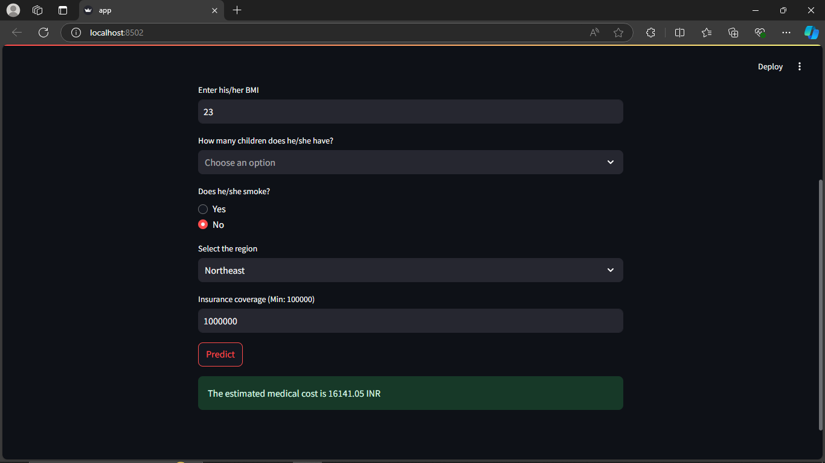
Result

Slide 19
Conclusion
The project simplifies healthcare insurance selection by providing personalized coverage estimates based on individual health data. By integrating real-time policy information and advanced machine learning, the system offers tailored recommendations, improving decision-making and user satisfaction. Continuous feedback will ensure ongoing refinement and effectiveness of the system.

Slide 20
Future work
1. Expanding Data Sources: Integrating additional insurance providers and policy types to offer a broader range of recommendations.
2. Enhancing Personalization: Incorporating more detailed health metrics and user preferences for even more tailored coverage estimates.
3. Improving Machine Learning Models: Refining algorithms to increase the accuracy and relevance of recommendations based on emerging data trends.
4. User Experience Upgrades: Enhancing the user interface and adding features based on feedback to further simplify the insurance selection process.

Slide 21
References
Mathur, P. (2019). Predicting Health Insurance Premiums with Machine Learning.
Gupta, A., Jha, R., & Misra, M. (2020). Machine Learning in Insurance: A Survey.
Centers for Disease Control and Prevention (CDC).
Mitchell, R. (2015). Web Scraping with Python: Collecting More Data from the Modern Web. O'Reilly Media.

Slide 22
Thank You!

